Slide 1
A Taste of English at Cambourne VC

Slide 2
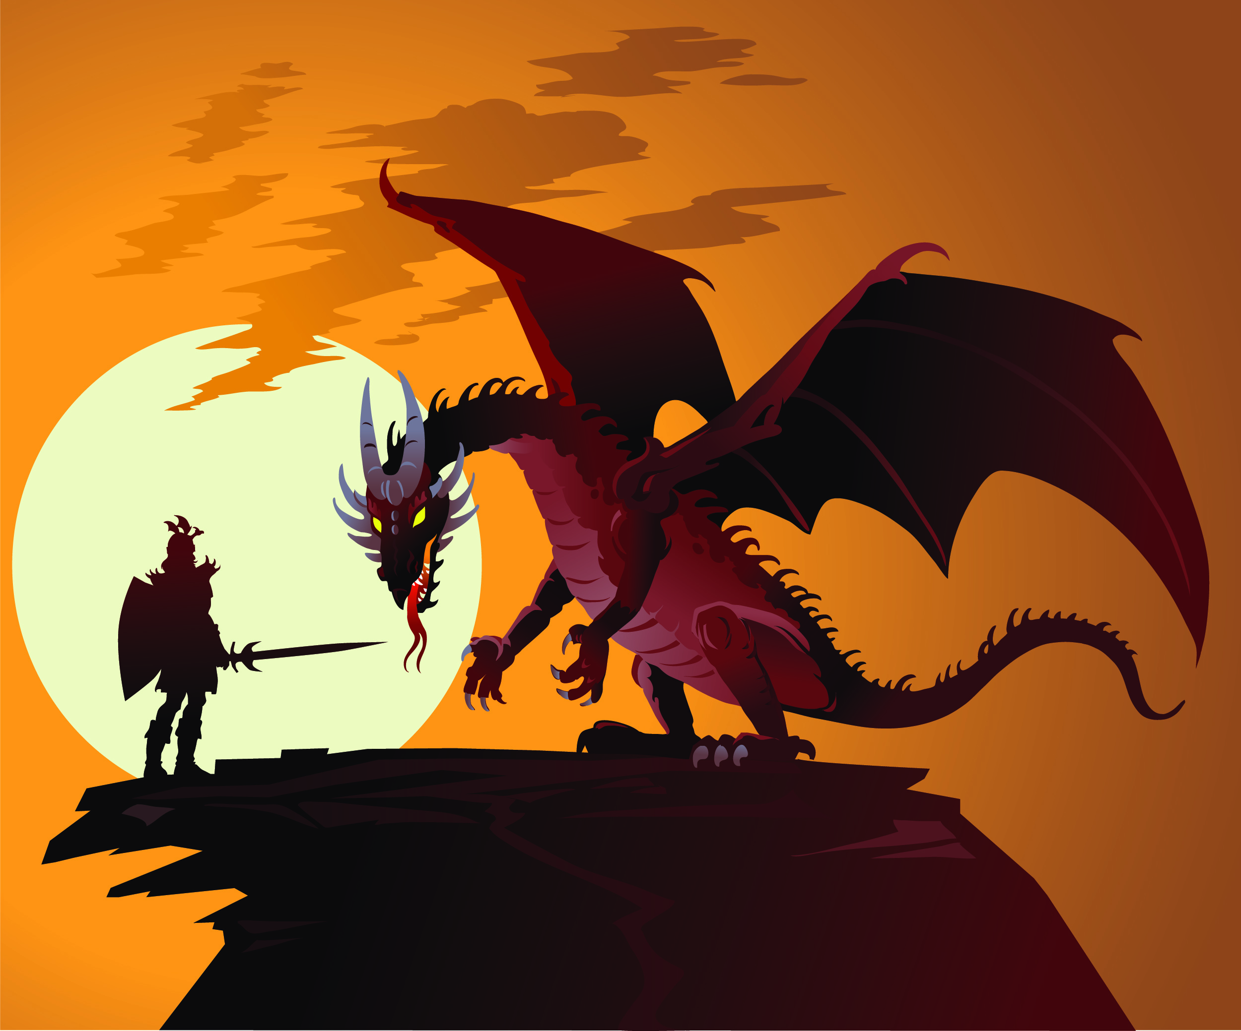
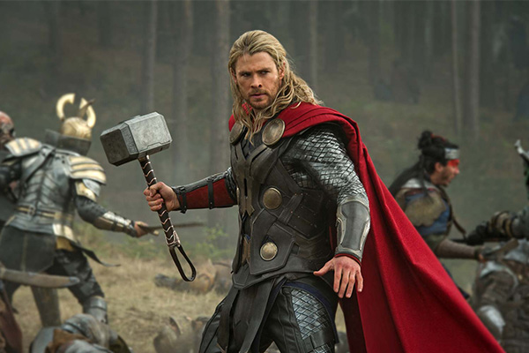
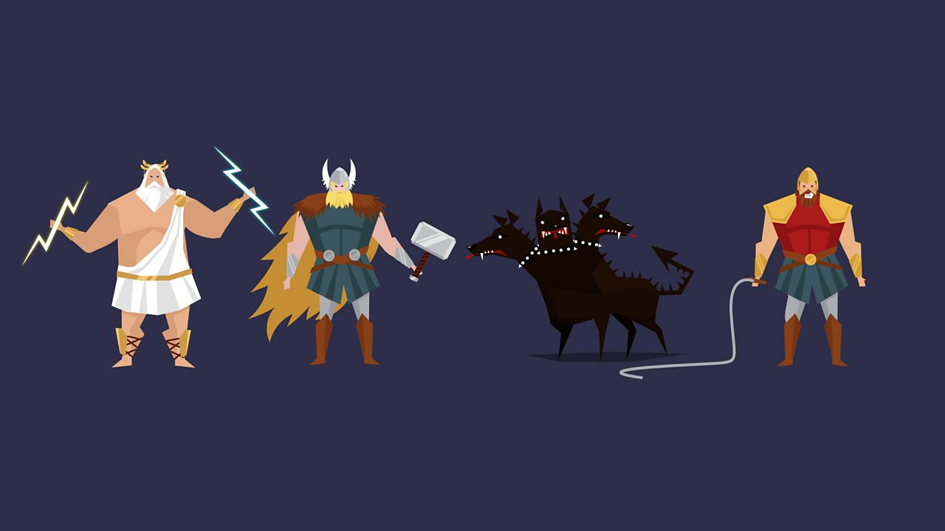
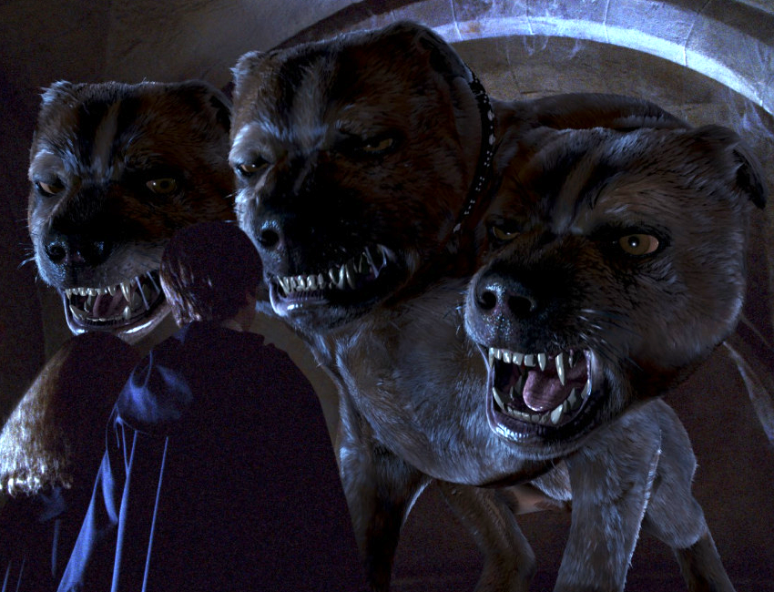
Your Starter
Your Starter
In your first half-term at Cambourne Village College, you will be studying a unit of work on myths and legends. Using the images on this slide to help you, discuss with your partner everything you already know about myths and legends: this could be a definition of either word, examples of myths and legends, or anything else!

Slide 3
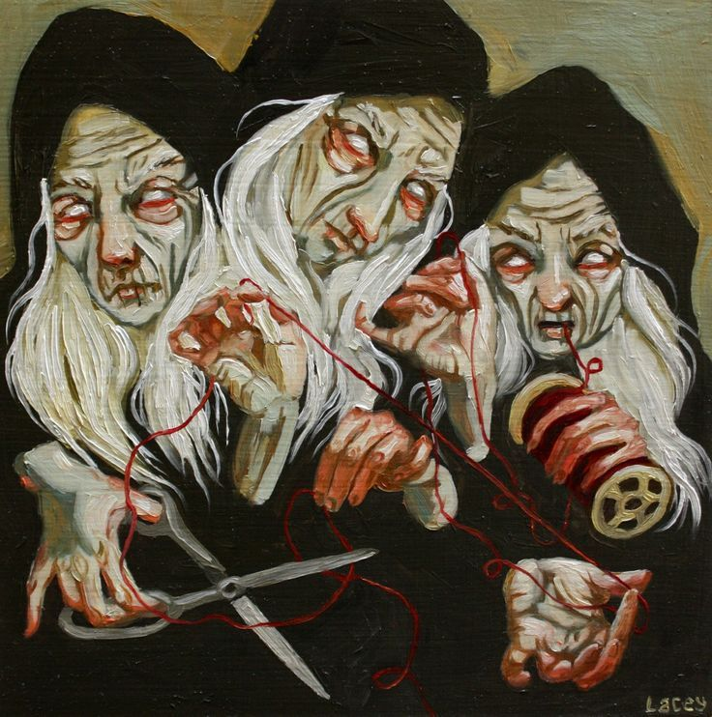
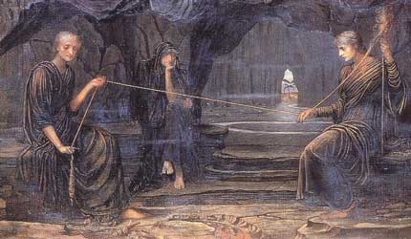
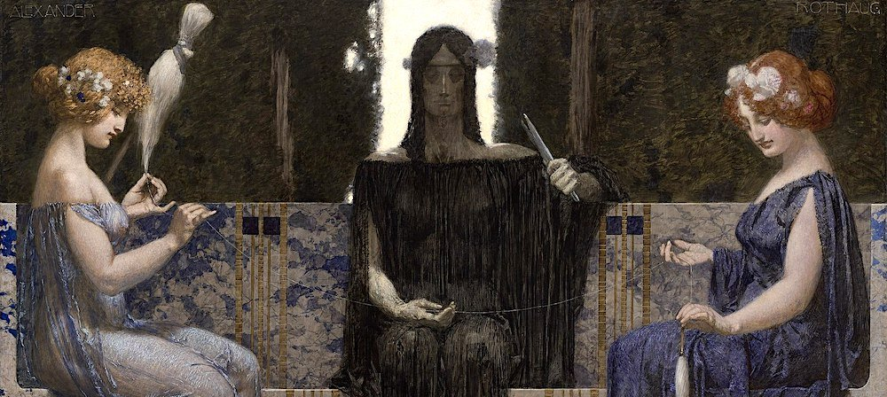
Your Main Activity
The Moirai
The myth and legend we are going to be focusing on today are the Moirai. From the images of them on this slide, can you answer the following questions in pairs:
What are they?
What do they do?
What would your reaction be if you saw them and why?

Slide 4
Your Main Activity
Quickfire Creative Writing
Now is your time to show off your creative writing skills. Write for five minutes about your character (it can be based on you or entirely fictional) meets the Moirai for the first time. Use the pictures and our class discussion for inspiration and if you are struggling, focus on describing your five senses.

Slide 5
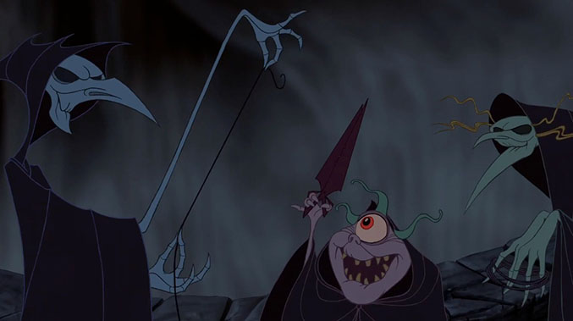
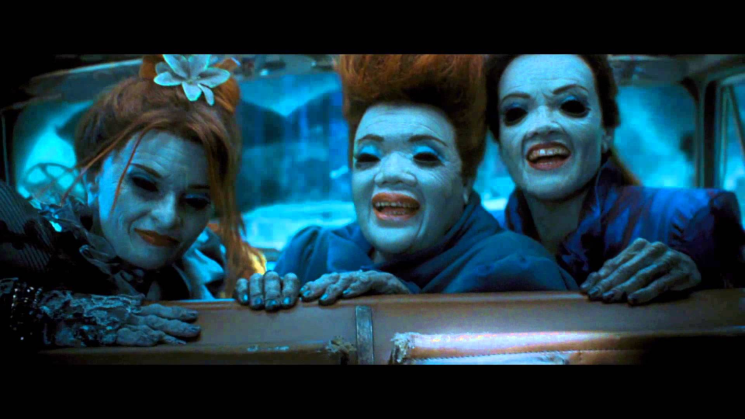
Your Main Activity
The Moirai
While you may not have heard of them before, the Moirai have been appearing in myths and legends since Ancient Greek times, approximately 2,500 years ago! They even appear in some stories you may be familiar with.

Slide 6
Your Main Activity
The Moirai Fact File
Their father was Zeus – ruler of Mount Olympus.
The Moirai had the power to decide: when someone was to be born (Clotho), how long they lived (Lachesis), when someone died (Atropos).
They were also known as the Three Fates or the Weird Sisters.
Moirai is a variation of the ancient Greek word moira. Moira comes from the words meros meaning ‘portion’ and moros meaning ‘fate’ or ‘doom’.

Slide 7
Your Main Activity
Before you go on to deciding your own and one another’s fates, let’s make sure we fully understand the word:
1. Note it – write down the definition of fate in your own words.
Fate
The development of events outside a person's control, regarded as predetermined by a supernatural power.
2. Write it – use the word in a sentence.
3. Argue it – in pairs discuss whether you believe in fate?

Slide 8
Your Main Activity
LOVE: You will be married at 28 yrs.
CHILDREN: 2 boys and 1 girl.
WEALTH: Annual Salary £147,000
CAREER: Lawyer
LIFE: You will live until you are 107
Fate
Write down your dream fate and your nightmare fate, using the template on this slide.

Slide 9
Your Main Activity
Roleplay
You are going to become the Fates. In groups of three:
decide who is Clotho whom decides when someone is born, who is Lachesis whom decides how long they live, and who is Atropos whom decides when someone dies.
2. Decide on a character whose fate you will determine. You can create a character, or use a fictional one whom you all know.
3. Create a scene in which you talk about the fate of the life you are controlling.
Use the planning sheet to help you!
OR
Storyboard
You are going to Storyboard an event using the Fates.
Decide on a character whose fate you will determine. You can create a character, or use a fictional one whom you all know.
2. Create a scene in which you design the fate of the life you are controlling. You must include information about when they are born, How long they will live and how they will die.
Use the storyboard sheet to help you!

Slide 10
Some helpful hints
Clotho: What time and date will they be born? Is this significant? Plan an event that might happen when they are born i.e power cut, clocks stop Where were they born? Inside /outside | Lachesis: List three significant things that happen in your character’s life e.g Job, marriage, children, happiness, an important event they are involved in 2. How long will they live? | Atropos: What time and date will they die on? Is this significant? i.e is it a birthday or an important date in History Where will they die? Inside/outside How do they die? Peacefully/Violently

Slide 11
Your Main Activity
Roleplay
Let’s hear some performances!

Slide 12
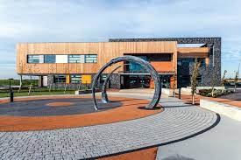
Q+A
Joining Cambourne Village College
It is very likely that you have some questions about joining Cambourne Village College.
Write down at least 1 question about life at Cambourne Village College.
Write down at least 1 question about English at Cambourne Village College.
Now let’s answer them!

